Slide 1
Data 695 Project Presentation
Walmart M5 Forecasting - Accuracy
Gautham Nagaraj
Joshua Quartley
Prince Oloma

Slide 2

The Data
The Kaggle repository consists of 5 datasets:
sales_train_validation.csv
Sales_train_evaluation.csv
Calender.csv
Sell_prices.csv
Sample_submissions.csv

Slide 3
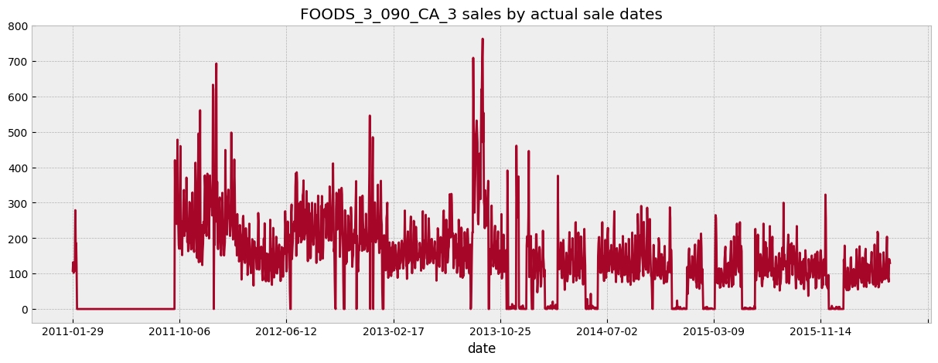
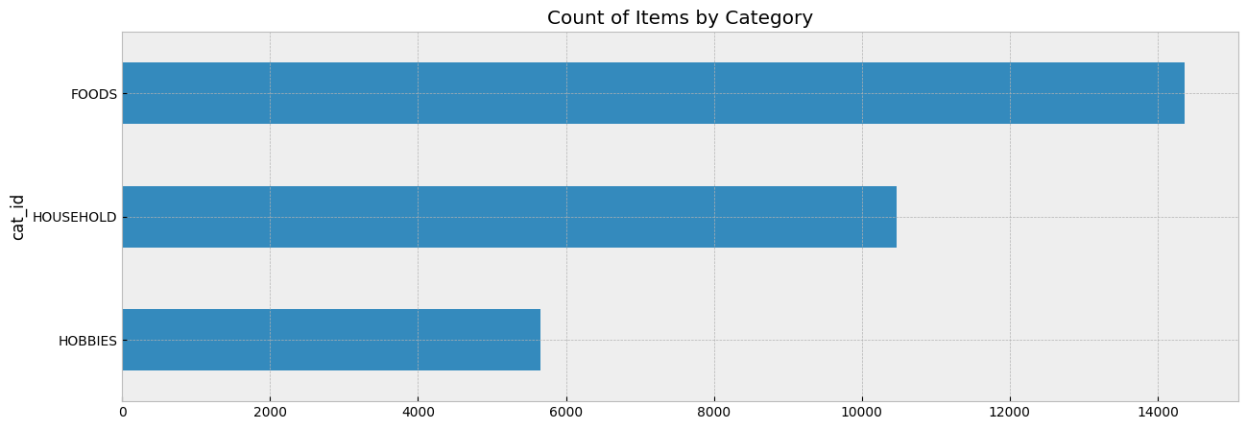
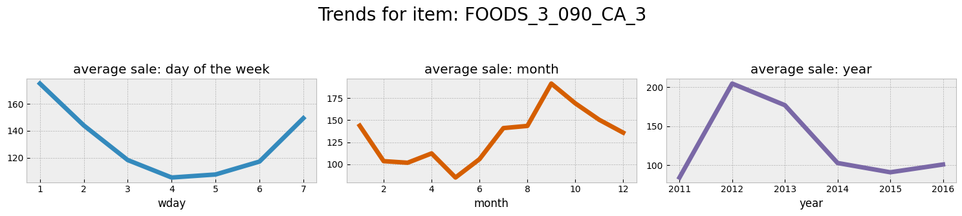
EDA

Slide 4

Feature Engineering
Features were added based off the calendar dataset:
Sales lags
Rolling average
Days before event

Slide 5
Baseline/Linear Models
The following linear models were used to obtain a baseline:
Ridge Regression
Lasso Regression
SGD Regression with partial fit
Facebook Prophet

Slide 6
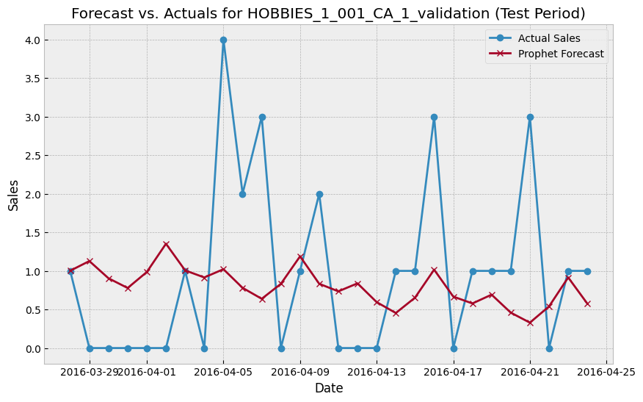
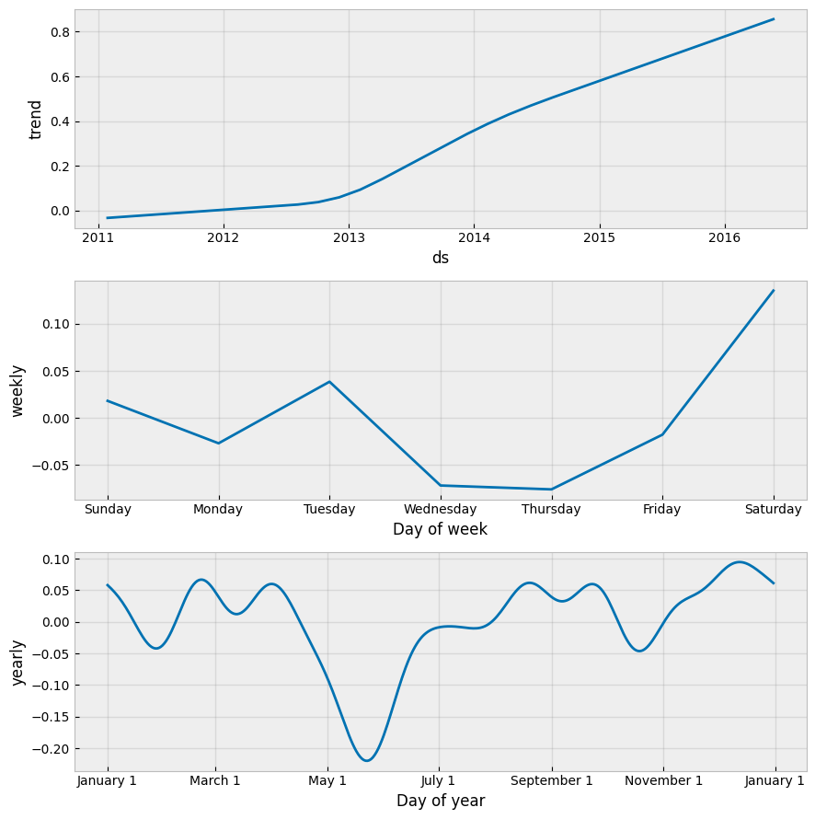
The baseline model - Prophet
Prediction for product HOBBIES_1_001_CA_1
Prediction vs Actual sales for HOBBIES_1_001_CA_1
Mean Absolute Percentage Error (MAPE): 44.68%
Root Mean Squared Error (RMSE): 1.18

Slide 7
Non-linear models

